Slide 1

Introduction to Corporate
Finance

Slide 2
Lecture Outlines
1.1 Corporate Finance and the Financial Manager
1.2 The Statement of Financial Position and Corporate Financial Decisions
1.3 The Corporate Form of Business Organisation
1.4 The Goal of Financial Management
1.5 The Agency Problem and Control of the Corporation
1.6 Financial Markets and the Corporation
1.7 The Two-period Perfect Certainty Model

Slide 3
Learning Objectives
Understand the basic idea of corporate finance.
Understand the importance of cash flows in financial decision making.
Discuss the three main decisions facing financial managers.
Know the financial implications of the three forms of business organisation.
Explain the goal of financial management and why it is superior to other possible goals.
Explain the agency problem, and how it can be can be controlled and reduced.
Outline the various types of financial markets.
Discuss the two-period certainty model and Fisher’s Separation Theorem.

Slide 4
What is Corporate Finance?
Corporate finance attempts to find the answers to the following questions:
  What investments should the business take on?
  THE INVESTMENT DECISION
  How can finance be obtained to pay for the required investments?
  THE FINANCE DECISION
  Should dividends be paid? If so, how much?
  THE DIVIDEND DECISION

Slide 5
The Financial Manager
Financial managers try to answer some or all of these questions.
The top financial manager within a firm is usually the General Manager–Finance.
  Corporate Treasurer or Financial Manager⎯oversees cash management, credit management, capital expenditures and financial planning.
  Accountant⎯oversees taxes, cost accounting, financial accounting and data processing.

Slide 6
The Investment Decision
Capital budgeting is the planning and control of cash outflows in the expectation of deriving future cash inflows from investments in non-current assets.
Involves evaluating the:
  size of future cash flows
  timing of future cash flows
  risk of future cash flows.

Slide 7
Cash Flow Size
Accounting income does not mean cash flow.
For example, a sale is recorded at the time of sale and a cost is recorded when it is incurred, not when the cash is exchanged.

Slide 8
Cash Flow Timing
A dollar today is worth more than a dollar at some future date.
There is a trade-off between the size of an investment’s cash flow and when the cash flow is received.

Slide 9
Cash Flow Timing
Which is the better project?
 | Future Cash Flows
Year | Project A | Project B
1 | $0 | $20 000
2 | $10 000 | $10 000
3 | $20 000 | $0
Total | $30 000 | $30 000

Slide 10
Cash Flow Risk
The role of the financial manager is to deal with the uncertainty associated with investment decisions.
Assessing the risk associated with the size and timing of expected future cash flows is critical to investment decisions.

Slide 11
Cash Flow Risk
Which is the better project?
 | Future Cash Flows
 | Pessimistic | Expected | Optimistic
Project 1 | $100 000 | $300 000 | $500 000
Project 2 | $200 000 | $400 000 | $600 000

Slide 12
Capital Structure
A firm’s capital structure is the specific mix of debt and equity used to finance the firm’s operations.
Decisions need to be made on both the financing mix and how and where to raise the money.

Slide 13
Working Capital Management
How much cash and inventory should be kept on hand?
Should credit terms be extended? If so, what are the conditions?
How is short-term financing acquired?

Slide 14
Dividend Decision
Involves the decision of whether to pay a dividend to shareholders or maintain the funds within the firm for internal growth.
Factors important to this decision include growth opportunities, taxation and shareholders’ preferences.

Slide 15
Corporate Forms of Business Organisation
The three different legal forms of business
organisation are:
sole proprietorship
partnership
company.

Slide 16
Sole Proprietorship
The business is owned by one person.
The least regulated form of organisation.
Owner keeps all the profits but assumes unlimited liability for the business’s debts.
Life of the business is limited to the owner’s life span.
Amount of equity raised is limited to owner’s personal wealth.

Slide 17
Partnership
The business is formed by two or more owners.
All partners share in profits and losses of the business and have unlimited liability for debts.
Easy and inexpensive form of organisation.
Partnership dissolves if one partner sells out or dies.
Amount of equity raised is limited to the combined personal wealth of the partners.
Income is taxed as personal income to partners.

Slide 18
Company
A business created as a distinct legal entity composed of one of more individuals or entities.
Most complex and expensive form of organisation.
Shareholders and management are usually separated.
Ownership can be readily transferred.
Both equity and debt finance are easier to raise.
Life of a company is not limited.
Owners (shareholders) have limited liability.

Slide 19
Possible Goals of Financial Management
Survival
Avoid financial distress and bankruptcy
Beat the competition
Maximise sales or market share
Minimise costs
Maximise profits
Maintain steady earnings growth

Slide 20
Problems with these Goals
Each of these goals presents problems.
These goals are either associated with increasing profitability or reducing risk.
They are not consistent with the long-term interests of shareholders.
It is necessary to find a goal that can encompass both profitability and risk.

Slide 21
The Firm’s Objective
The goal of financial management is to maximise shareholders’ wealth.
Shareholders’ wealth can be measured as the current value per share of existing shares.
This goal overcomes the problems encountered with the goals outlined above.

Slide 22
Agency Relationships
The agency relationship is the relationship between the shareholders (owners) and the management of a firm.
The agency problem is the possibility of conflict of interests between these two parties.
Agency costs refer to the direct and indirect costs arising from this conflict of interest.

Slide 23
Do Managers Act in Shareholders’ Interests?
The answer to this will depend on two factors:
how closely management goals are aligned with shareholder goals
the ease with which management can be replaced if it does not act in shareholders’ best interests.

Slide 24
Alignment of Goals
The conflict of interests is limited due to:
management compensation schemes
monitoring of management
the threat of takeover
other stakeholders.

Slide 25
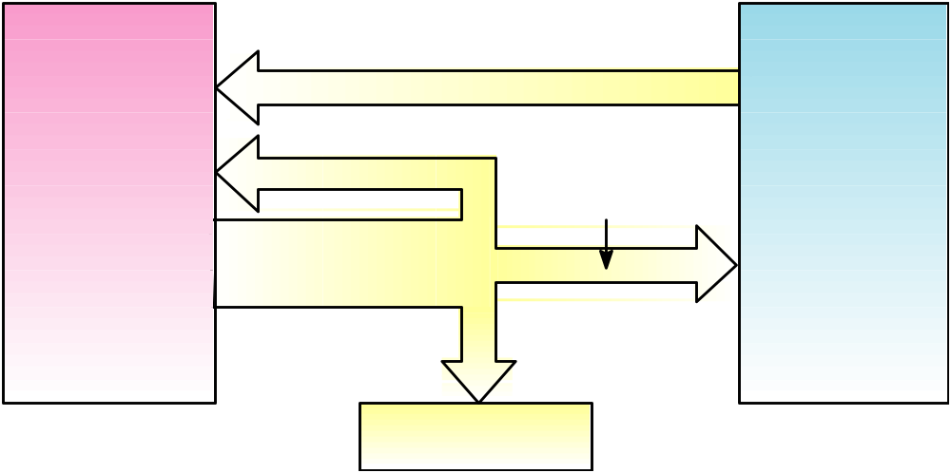
Cash Flows between the Firm and the Financial Markets
Total Value of the Firm
to Investors in
the Financial Markets
Total Value of
Firm’s Assets
B. Firm invests in assets
Current Assets Fixed Assets
A. Firm issues securities
Financial
Markets
Short-term debt
Long-term debt
Equity shares
E. Retained cash flows
F. Dividends and
debt payments
C. Cash flow from
firm’s assets
D. Government

Slide 26
Financial Markets
Financial markets bring together the buyers and sellers of debt and equity securities.
Money markets involve the trading of short-term debt securities.
Capital markets involve the trading of long-term debt securities.
Primary markets involve the original sale of securities.
Secondary markets involve the continual buying and selling of issued securities.

Slide 27
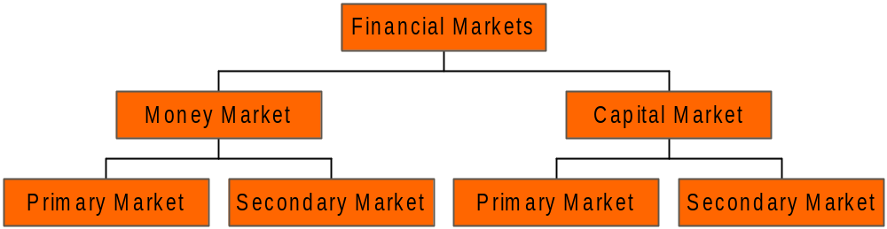
Structure of Financial Markets

Slide 28
Two-period Perfect Certainty Model
Explains the behaviour of firms and individuals.
Relies on three assumptions:
  perfect certainty
  perfect capital markets
  rational investors.

Slide 29
Two-period Perfect Certainty Model
The certainty model uses two periods—now (period 1) and the future (period 2).
Individuals make consumption choices based on their tastes and preferences and the investment opportunities available to them.
Utility curves represent indifference between period 1 (consume now) and period 2 (invest now, consume later) consumption.

Slide 30
Utility Curves
Period 2
Utility curves
q
p
Period 1

Slide 31
Representation of Opportunities
Opportunities facing firms in a two-period world include:
  investment/production
  payment of dividends.
The production possibility frontier represents attainable combinations of period 1 (pay dividend now) and period 2 (invest now, pay dividend later) dollars from a given endowment of resources.

Slide 32
Production Possibility Frontier
Period 2
210
Production possibility frontier
160
100
150
Period 1

Slide 33
Utility Maximisation
Firms should invest funds until they reach a point on the production frontier that is just tangential to the market line.
This then places the owner on the highest possible utility curve given the resources available.
At this point, the owner’s utility is maximised.
However, a problem exists if there is more than one owner.

Slide 34
Solution for Multiple Owners
Introduce a capital market—resources can be transferred between the present and the future.
Add the market line.
This produces an optimal investment policy where production possibility frontier is tangential to the market line.
Consumption decisions can be made using the capital market.

Slide 35
Optimal Investment Policy
Period 2
Market line
Optimal policy
Period 1

Slide 36
Fisher’s Separation Theorem
In a perfect capital market, it is possible to separate the firm’s investment decisions from the owners’ consumption decisions.

Slide 37
The Investment Decision
The point of wealth and utility maximisation for all shareholders can be reached through one of two rules:
  Net present value rule: invest so as to maximise the net present value of the investment.
  Internal rate of return rule: Invest up to the point at which the marginal return on the investment is equal to the expected rate of return on equivalent investments in the capital market.

Slide 38
Implications of Fisher’s Analysis
It is only the investment decision that affects firm value.
Firm value is not affected by how investments are financed or how the distribution (dividends) are made to the owners.

